Slide 1

MOVIE RECOMMENDATION SYSTEM USING K-MEANS CLUSTERING ALGORITHM
HINDUSTHAN COLLEGE OF ENGINEERING AND TECHNOLOGY
TEAM MEMBERS
ANISHA S C ( 20104009)
YOSHITHA SRI H A (20104064)

Slide 2
ABSTRACT
K-means clustering is a fundamental unsupervised machine learning algorithm for data grouping and pattern discovery.
It operates by partitioning a dataset into a predefined number of clusters, aiming to minimize the intra-cluster variance while maximizing the inter-cluster separation.
The algorithm iteratively assigns data points to the nearest cluster center and recalculates the cluster centers until convergence.
K-means has broad applications in various fields, such as customer segmentation, image compression, recommendation systems, and anomaly detection.
Its simplicity and computational efficiency make it popular for clustering tasks. Still, it assumes that clusters are spherical and equally sized, which can limit its effectiveness on complex data distributions.

Slide 3
INTRODUCTION
The project at hand introduces a movie recommendation system that employs K-means clustering, a clustering algorithm typically used for grouping data into clusters, in a novel context.
The project begins with the preparation of user rating data, where user ratings for various movies are collected and structured into a user-item matrix.
Subsequently, K-means clustering is applied to this matrix to group similar movies into clusters based on user ratings.
Each user is then assigned to a cluster, and recommendations are made from the same cluster. While this approach provides movie suggestions, it does so without the personalization of collaborative filtering techniques.
The project offers a simplified Python implementation as a starting point and discusses potential improvements and extensions to enhance the recommendation system's effectiveness and user satisfaction.

Slide 4
EXISTING SYSTEM
Traditional recommendation systems rely on collaborative filtering, content-based filtering, and matrix factorization techniques, as they offer better personalization and more accurate movie recommendations.
Netflix uses a combination of recommendation algorithms, including collaborative filtering and content-based filtering. Their recommendation system analyzes user viewing history, user ratings, and content metadata to suggest movies and TV shows to subscribers.
Amazon Prime Video employs machine learning algorithms to recommend movies and TV shows based on a user's viewing history, purchase history, and user-generated content reviews.
User-Based Collaborative Filtering: Recommends movies based on the preferences of similar users. Item-Based Collaborative Filtering: Recommends movies similar to those a user has already liked or watched.

Slide 5
PROPOSED SOLUTION
Imagine a movie recommendation system that not only understands your taste in films but also groups similar movies together for personalized suggestions. Our proposed solution leverages the power of the K-Means clustering algorithm to achieve precisely that.
Key Components:
User Preferences Analysis: We start by collecting user preferences and behaviors, such as movie ratings, genres of interest, and viewing history.
Feature Extraction: Extract relevant features from the movie dataset, including genre, director, actors, and user ratings.
Personalized Recommendations: Once the clustering is complete, the system recommends movies based on the user's preferences and the cluster they belong to. Users will receive recommendations not only based on their past choices but also on movies within the same cluster.

Slide 6
Dynamic Clustering: The system continuously updates clusters based on new user data and movie additions. This ensures that recommendations stay relevant and adapt to evolving user preferences.
Personalization: Users receive movie recommendations tailored to their unique preferences and behaviors.
Novel Suggestions: Discover new movies within the same cluster that align with the user's taste but may not have been on their radar.
Adaptability: The system evolves over time, ensuring that recommendations stay fresh and in tune with changing user preferences.

Slide 7
FUTURE ENHANCEMENT
Combine the benefits of K-Means clustering with other recommendation techniques, such as collaborative filtering or content-based filtering.
This hybrid approach can enhance the system's ability to provide accurate recommendations at both the cluster and individual levels.
Address privacy concerns by providing users with control over the level of personalization.
Implement robust privacy measures to ensure that user data is handled securely and ethically. Balancing the need for personalization with user privacy concerns.
Ensuring that the system remains scalable and efficient even with the added complexity of individual user profiles

Slide 8
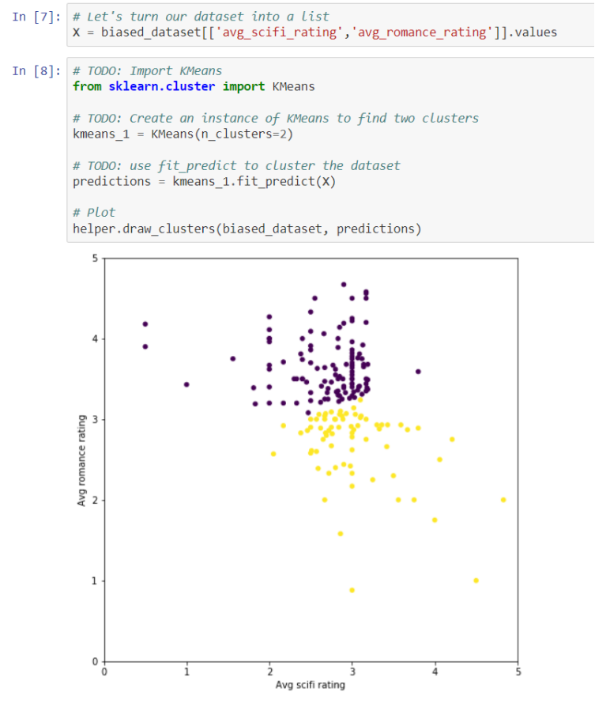
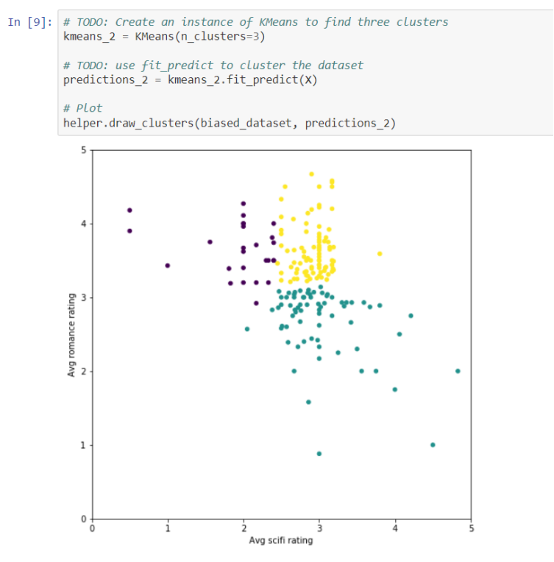
OUTPUT SCREENSHOT

Slide 9
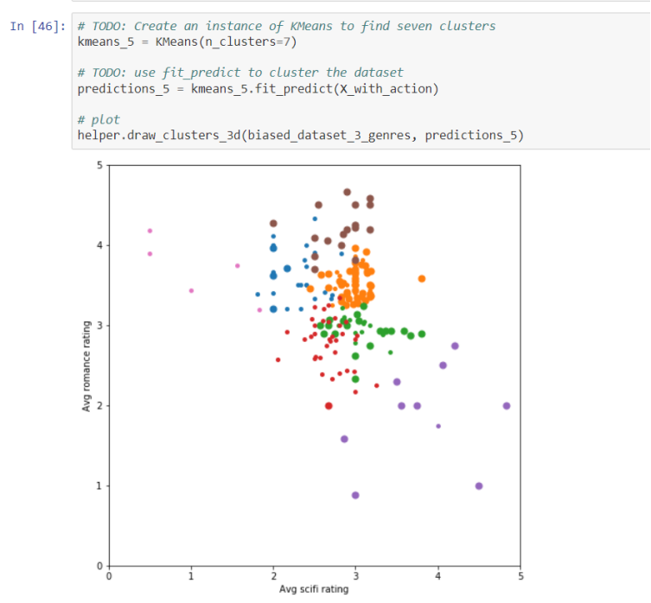
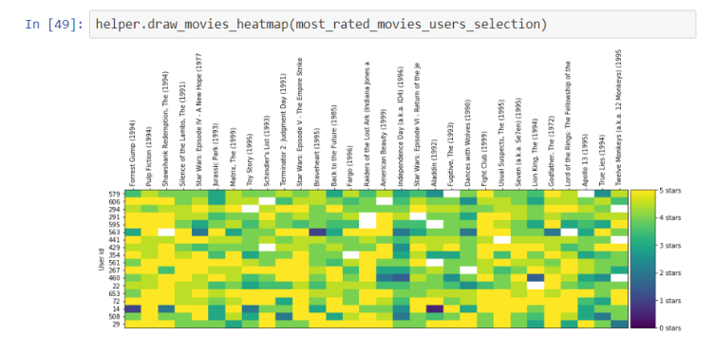

Slide 10



CONCLUSION
The Movie Recommendation System we constructed is a testament to the algorithm's efficacy, offering a tailored movie journey for every user.
We recognize that the landscape of recommendation systems is ever-evolving.
New algorithms, innovative features, and richer datasets await exploration. Our journey with K-Means is but a stepping stone in this vast terrain, urging future researchers and developers to continue unraveling the mysteries of personalized content delivery.
In the realm of movie recommendations, the K-Means Clustering Algorithm has proven itself a stalwart companion, inviting users to not just watch movies but to embark on curated cinematic adventures tailored to their unique tastes.

Slide 11
REFERENCES
"Introduction to Data Mining" by Pang-Ning Tan, Michael Steinbach, and Vipin Kumar.
"Data Science for Business" by Foster Provost and Tom Fawcett.
"Machine Learning: A Probabilistic Perspective" by Kevin P. Murphy.
Lloyd, S. (1957). "Least Squares Quantization in PCM."
MacQueen, J. B. (1967). "Some Methods for classification and Analysis of Multivariate Observations.“
Arthur, D., & Vassilvitskii, S. (2007). "k-means++: The advantages of careful seeding."
Elkan, C. (2003). "Using the triangle inequality to accelerate k-means."

Slide 12
Thank you

